Slide 1
Navigating the Skies: A Mathematical Network Analysis of International Air Travel Dynamics (2000-2020)
Preyasi Gaur, Michael Bruynell, Manasi Indolikar
Notes:
Speaker:

Slide 2
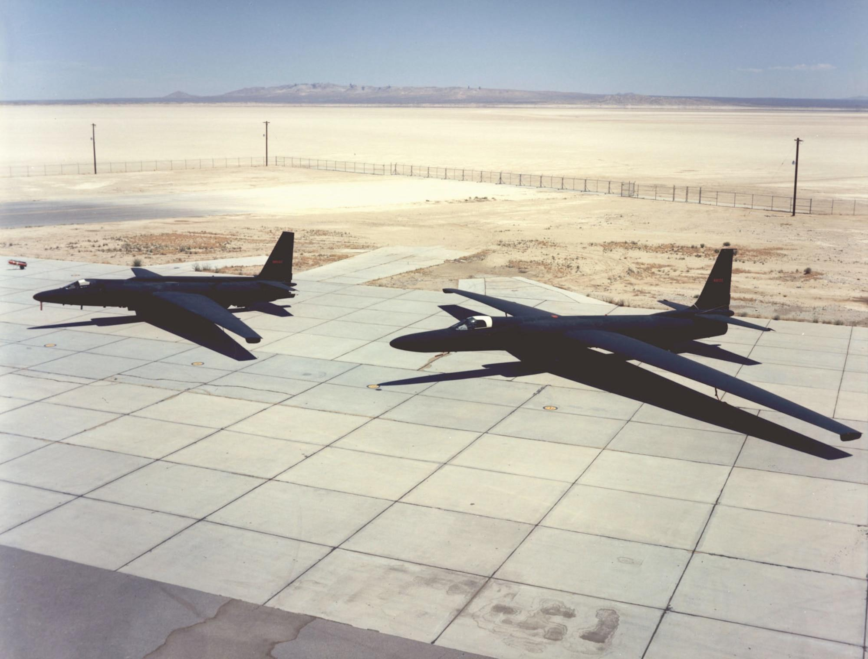
Introduction
Research Focus (2000-2020):
Our research examines the evolution of international air travel.
Utilizing mathematical network analysis for ticket pricing dynamics.
Impactful Global Events:
Exploration of how global disruption to the network shapes ticket pricing dynamics.
Methodology and Insights:
We utilized mathematical network analysis techniques such as PageRank, degree centrality, network density, average degree, temporal analysis, communities
Notes:
Speaker: Manasi

Slide 3
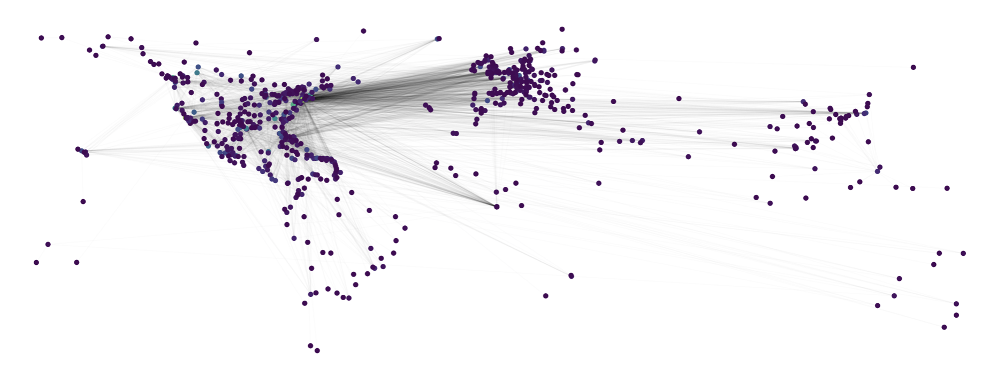

Question:
What are the factors affecting international airline ticket pricing?
Behavior in airport network?
Global Disruptions?
Notes:
Speaker: Mikey
Notes:
Our question to analyze is what are the factors affecting international airline ticket pricing?
We want to examine the correlation between ticket pricing and an international airport network.
We will do this by looking at key hub airports, connectivity over time, and the effects of network disruptions such Covid-19

Slide 4

Data
The primary data for analysis was sourced from International Air Travel Dataset (1990 - 2023): the U.S. Bureau of Transportation Statistics

Slide 5

Theory
Page Rank
Higher scores for nodes with vital connections.
Degree Centrality
Quantifies the number of connections relative to potential connections.
High degree centrality indicates pivotal hubs; low centrality indicates fewer connections.
Temporal connectivity analysis
Average Degree
Computed as the average count of edges originating from each node.
Network Density
The number of nodes connected relative to the number of connections available
Elevated density signifies heightened utilization of potential flight connections
Communities
Identification of clusters of airports exhibiting robust connections.
Clusters based on factors like geographical proximity, airline alliances, or shared operational characteristics.
Notes:
Speaker: Preyasi
Briefly state the concepts that we will be going over (PageRank, Degree Centrality, growth of connectivity,...)

Slide 6
Network Analysis I
Created a multigraph representation with weighted edges focusing on passenger volume and its inverse
Explored theoretical concepts, PageRank and Degree Centrality, to assess airport importance in the network.
Hypothesized that these metrics would correlate with ticket pricing, with PageRank considering connectivity strength and Degree Centrality focusing on direct flight connections.
Presented PageRank and Degree Centrality analyses for Top 10 and Bottom 10 airports based on ticket pricing.
Revealed how highly connected airports, like JFK and LAX, exhibit competitive pricing dynamics, while less connected ones may experience less favorable fares.
Notes:
Speaker: Manasi
Data Extraction and Graph Creation:
Utilized data extraction techniques to analyze international air travel data from 2019.
Created a MultiGraph representation with weighted edges, focusing on passenger volume and its inverse, forming the foundation for subsequent analyses.
PageRank and Degree Centrality:
Explored theoretical concepts, PageRank and Degree Centrality, to assess airport importance in the network.
Hypothesized that these metrics would correlate with ticket pricing, with PageRank considering connectivity strength and Degree Centrality focusing on direct flight connections.
Airport Ranking Analysis:
Presented PageRank and Degree Centrality analyses for Top 10 and Bottom 10 airports based on ticket pricing.
Revealed how highly connected airports, like JFK and LAX, exhibit competitive pricing dynamics, while less connected ones may experience less favorable fares.
Impact on Decision-Making:
Summarized findings, emphasizing the pivotal role of highly connected airports in shaping global air travel dynamics.
Established a foundation for strategic decision-making in the aviation industry by highlighting the intricate relationship between network structures and ticket pricing dynamics.

Slide 7
Network Analysis I (cont.)
PageRank Analysis:
Top 10 Airports:
JFK (Rank: 1, PageRank: 0.0158)
BOS (Rank: 16, PageRank: 0.0097)
IAD (Rank: 15, PageRank: 0.0116)
LAX (Rank: 2, PageRank: 0.0161)
ORD (Rank: 8, PageRank: 0.0077)
EWR (Rank: 5, PageRank: 0.0125)
MIA (Rank: 3, PageRank: 0.0176)
SFO (Rank: 7, PageRank: 0.0087)
MCO (Rank: 17, PageRank: 0.0081)
RDU (Rank: 194, PageRank: 0.0025)
Bottom 10 Airports:
HNL (Rank: 23, PageRank: 0.0064)
FAT (Rank: 197, PageRank: 0.0009)
OKC (Rank: 651, PageRank: 0.0006)
BOI (Rank: 714, PageRank: 0.0003)
LGB (Rank: 730, PageRank: 0.0003)
TUS (Rank: 341, PageRank: 0.0014)
ECP (Rank: Not found, PageRank: 0)
OAK (Rank: 117, PageRank: 0.0026)
CAK (Rank: 768, PageRank: 0.0003)
ORH (Rank: Not found, PageRank: 0)
Degree Centrality Analysis:
Top 10 Airports:
JFK (Rank: 4, Degree Centrality: 0.164)
BOS (Rank: 10, Degree Centrality: 0.110)
IAD (Rank: 7, Degree Centrality: 0.126)
LAX (Rank: 5, Degree Centrality: 0.164)
ORD (Rank: 15, Degree Centrality: 0.0943)
EWR (Rank: 6, Degree Centrality: 0.141)
MIA (Rank: 2, Degree Centrality: 0.176)
SFO (Rank: 13, Degree Centrality: 0.0975)
MCO (Rank: 12, Degree Centrality: 0.0975)
RDU (Rank: 79, Degree Centrality: 0.0307)
Bottom 10 Airports:
HNL (Rank: 44, Degree Centrality: 0.0445)
FAT (Rank: 254, Degree Centrality: 0.0085)
OKC (Rank: 354, Degree Centrality: 0.0053)
BOI (Rank: 526, Degree Centrality: 0.0021)
LGB (Rank: 575, Degree Centrality: 0.0021)
TUS (Rank: 167, Degree Centrality: 0.0148)
ECP (Rank: Not found, Degree Centrality: 0)
OAK (Rank: 81, Degree Centrality: 0.0297)
CAK (Rank: 533, Degree Centrality: 0.0021)
ORH (Rank: Not found, Degree Centrality: 0)
Notes:
Analysis of airport connectivity within the international air travel network reveals distinct patterns in ticket pricing dynamics. Specifically from this I can tell that highly connected airports, such as JFK, LAX, and MIA, show us significant competitiveness among airlines, resulting in more favorable ticket pricing for passengers. These airports, characterized by top ranks in both PageRank and Degree Centrality, offer a diverse range of carriers and attractive fares, making them crucial hubs for travelers.
Moreover, moderately connected airports like BOS strike a balance between demand and competition, providing passengers with reasonable fares and flight options. This suggests that a moderate level of connectivity contributes to a competitive pricing environment, benefiting travelers.
On the other hand, less connected airports, as we can see by RDU, may experience limited competitive pressure, which may lead to less favorable fares and a constrained range of flight options for passengers. My analysis indicates that the strategic importance and connectivity of airports significantly shape the competitive landscape, which influences ticket pricing dynamics and, consequently, the travelers’ choices.
Moreover, when examining the Bottom 10 airports we can understand more about the pricing landscape. Airports like HNL and OAK, with moderate connectivity, show me that there is a somewhat competitive pricing environment, providing passengers with a reasonable range of flight options and fares. However, airports at the lower end of the network, like FAT and CAK, demonstrate lower overall importance and connectivity, resulting in potentially less competitive pricing and a more restricted choice of flights for passengers. This is what I see from my analysis.
Overall, my detailed analysis shows us the impact of airport connectivity on ticket pricing within the international air travel network. Highly connected airports show us competitive dynamics, which lead to attractive fares, while lower connectivity may result in less competitive pricing and limited flight options. I was able to learn that decisions and possible cost savings are tied to the strategic importance of airports in the broader network.

Slide 8
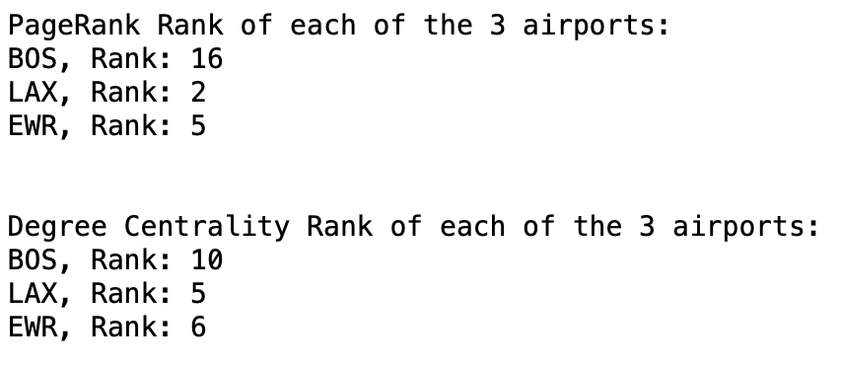
Network Analysis II
Python Output:
Airports to analyze:
Boston, LAX, Newark
Comparable airports?
PageRank and Degree Centrality
Notes:
The airports I choose to analyze were Boston, LAX, and Newark
To prevent unfair comparison I first see if they have similar importance on the international network.
Comparing two airports with very different centrality values can lead to misleading results
For example an airport with high centrality will likely have more routes of longer distances when compared to an airport with very low centrality. This can cause problems when we look at the average ticket price per airport.
Using Python I found PageRank and Degree centrality of all 3 airports and ranked them based on their significance. Out of 945 total airports, I found that all 3 airports were either top 20 or top 10 in centrality measures.
This gives us confidence for comparing the airports

Slide 9
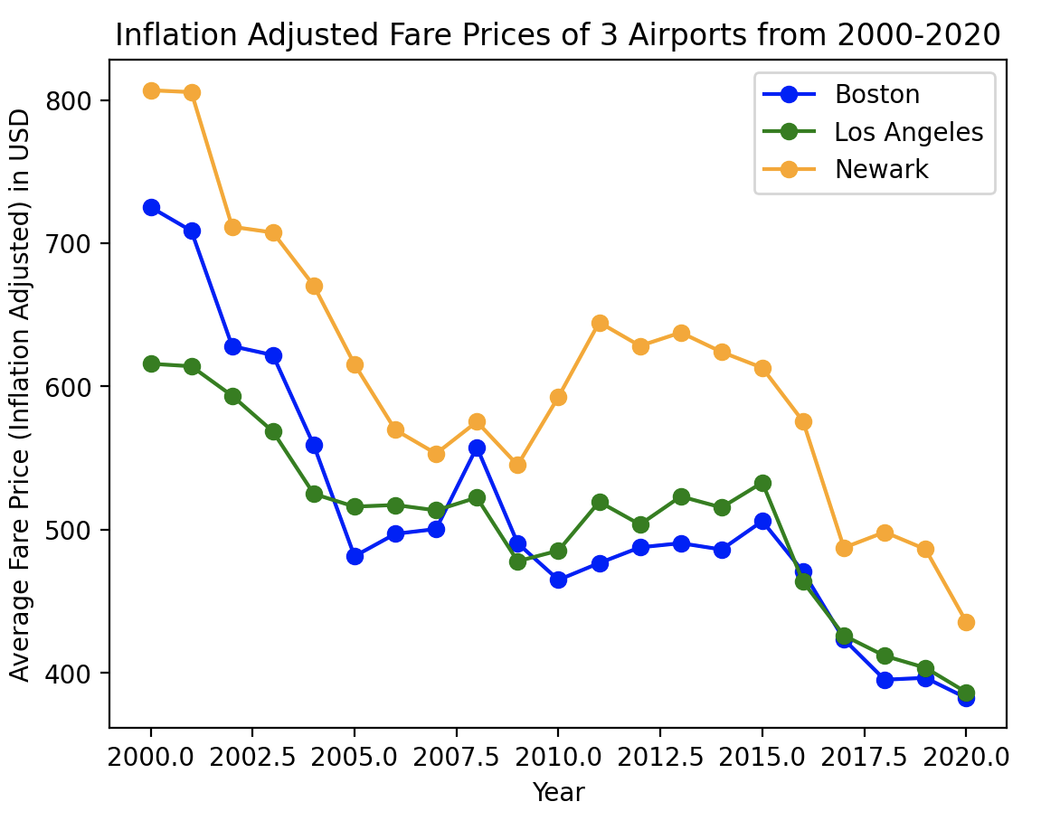
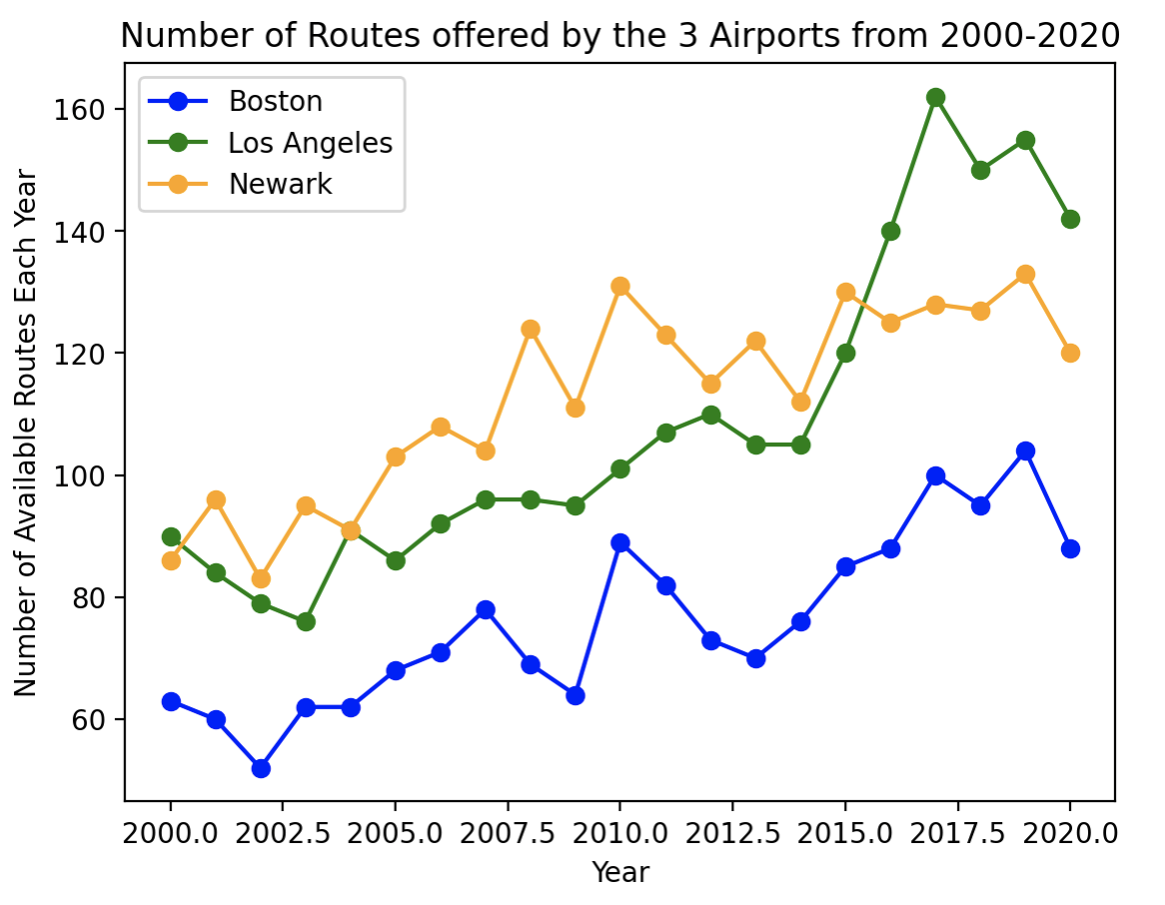
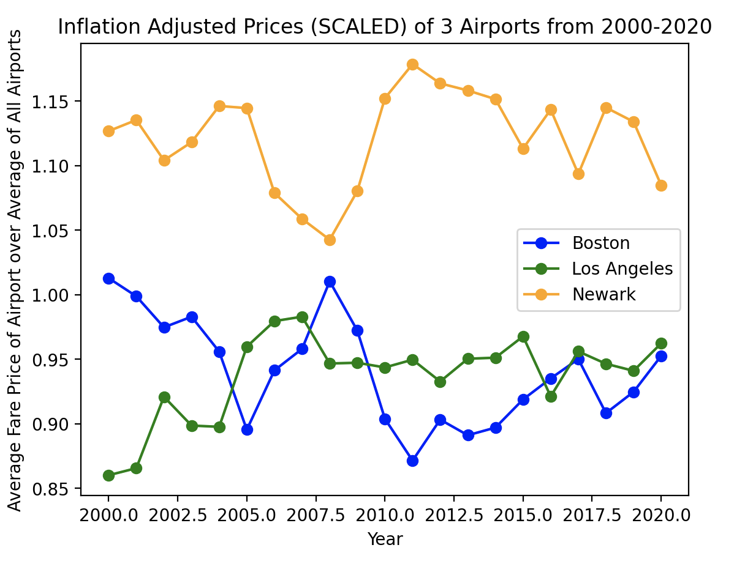
Network Analysis II (cont.)
Average Fare per Year:
Growth in Connectivity:
Relative Average Fare:
Notes:
Speaker: Michael
Here I plotted the number of available routes for each airport over the course of 20 years. I then plotted the average ticket price for each airport over the same time period. Keep in mind that these are inflation adjusted values.
We can see a positive trend in the connectivity of these airports over time, with small dips around 2008 and 2020, which could be due to market crash and covid pandemic. Now if we look at the corresponding ticket graph, we can see that as connectivity increases, the ticket prices decrease.
To further support my claim, I made a similar ticket graph but this time I used relative average ticket prices. This means the average ticket price of each airport is divided by the average ticket price of all the airports that year. I did this so I could assess the individual average compared to the groups average. If the decrease in ticket prices were happening for all airports and had nothing to do with connectivity, it would be shown on this graph.
Although this graph has a more subtle relationship, we can see Newark and Boston, that there is still a negative correlation between connectivity and ticket pricing. LAX however does not maintain this relationship.
The results of this method make sense intuitively and align with some microeconomic principles. One example would be heightened competition among airlines. If airports increase their number of routes, more airlines could serve those routes which would foster competition. As many of you know, competition tends to drive prices down.

Slide 10
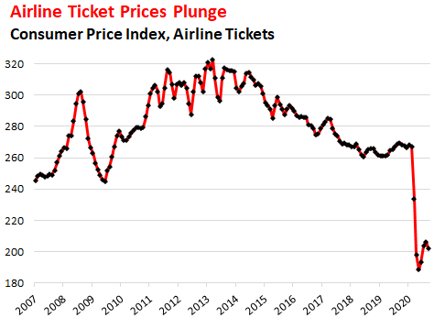
Network Analysis III
Airline industry was impacted during the Great Recession and COVID-19, but how does the change in network correlate with this?
Source: wolfstreet.com
Notes:
Preyasi

Slide 11
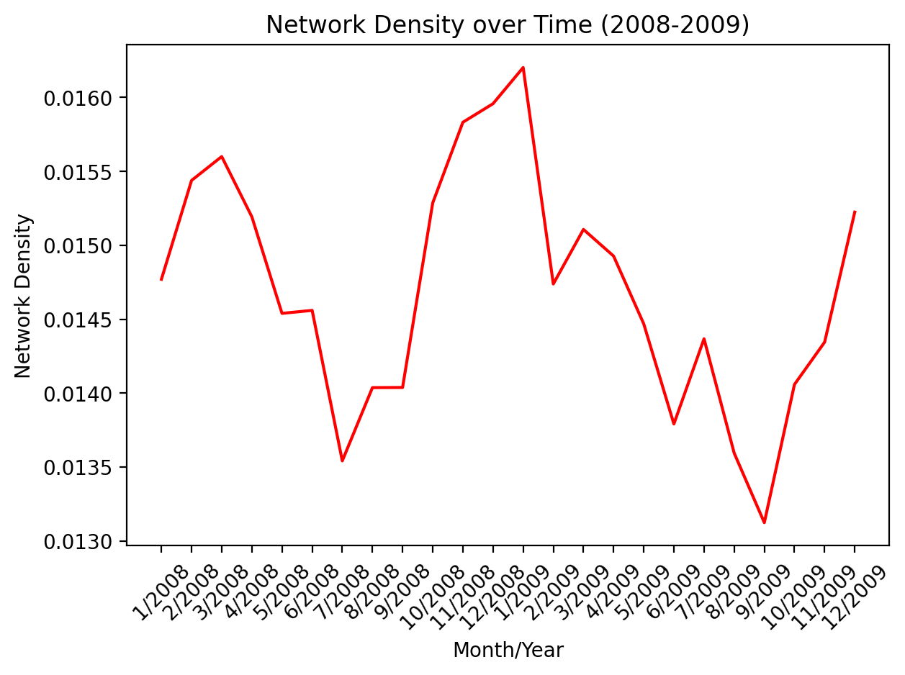
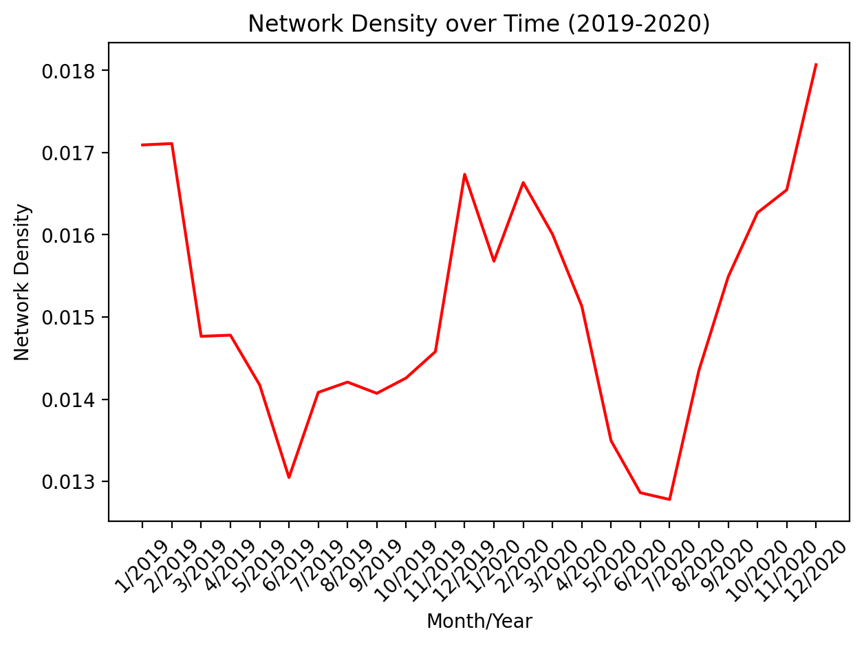
Network Analysis III
Great Recession COVID-19
Notes:
Preyasi

Slide 12
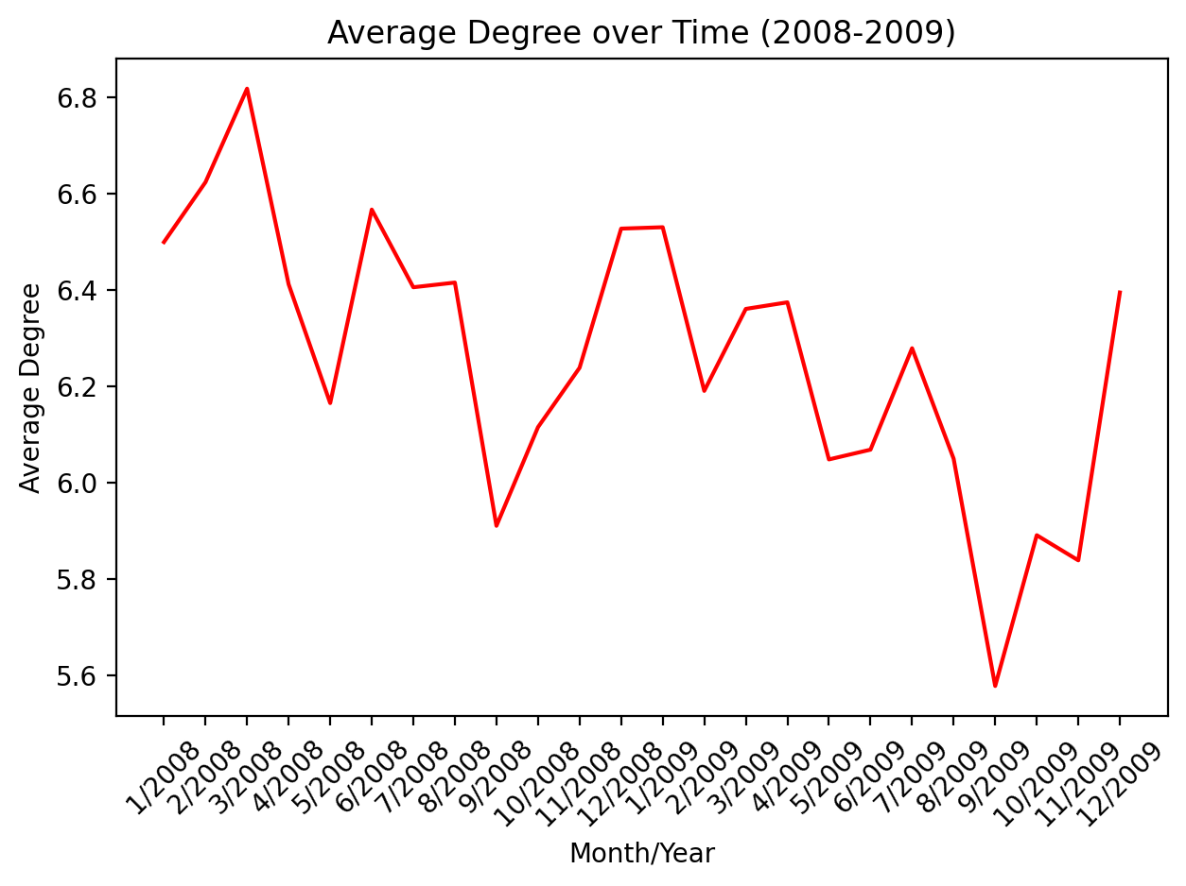
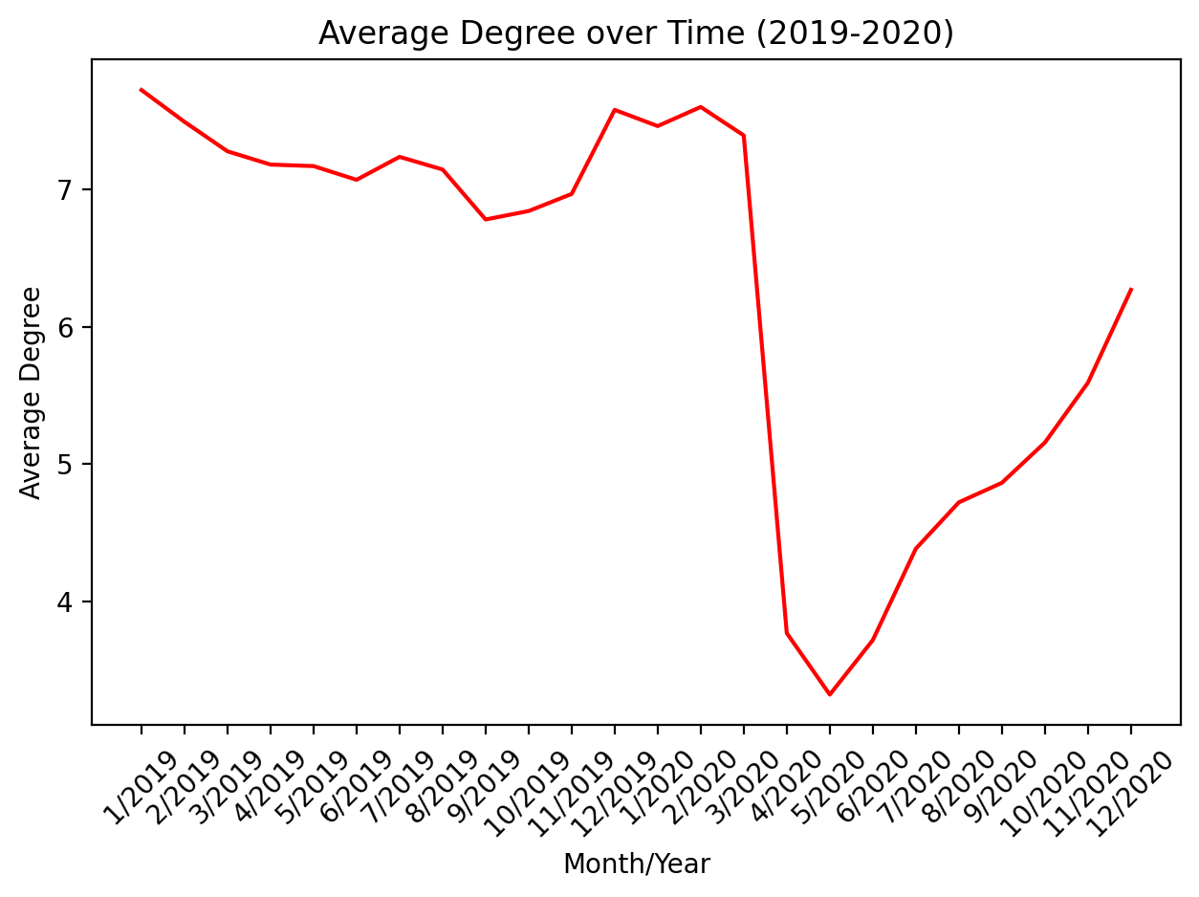
Network Analysis III
Great Recession COVID-19
Notes:
Preyasi

Slide 13
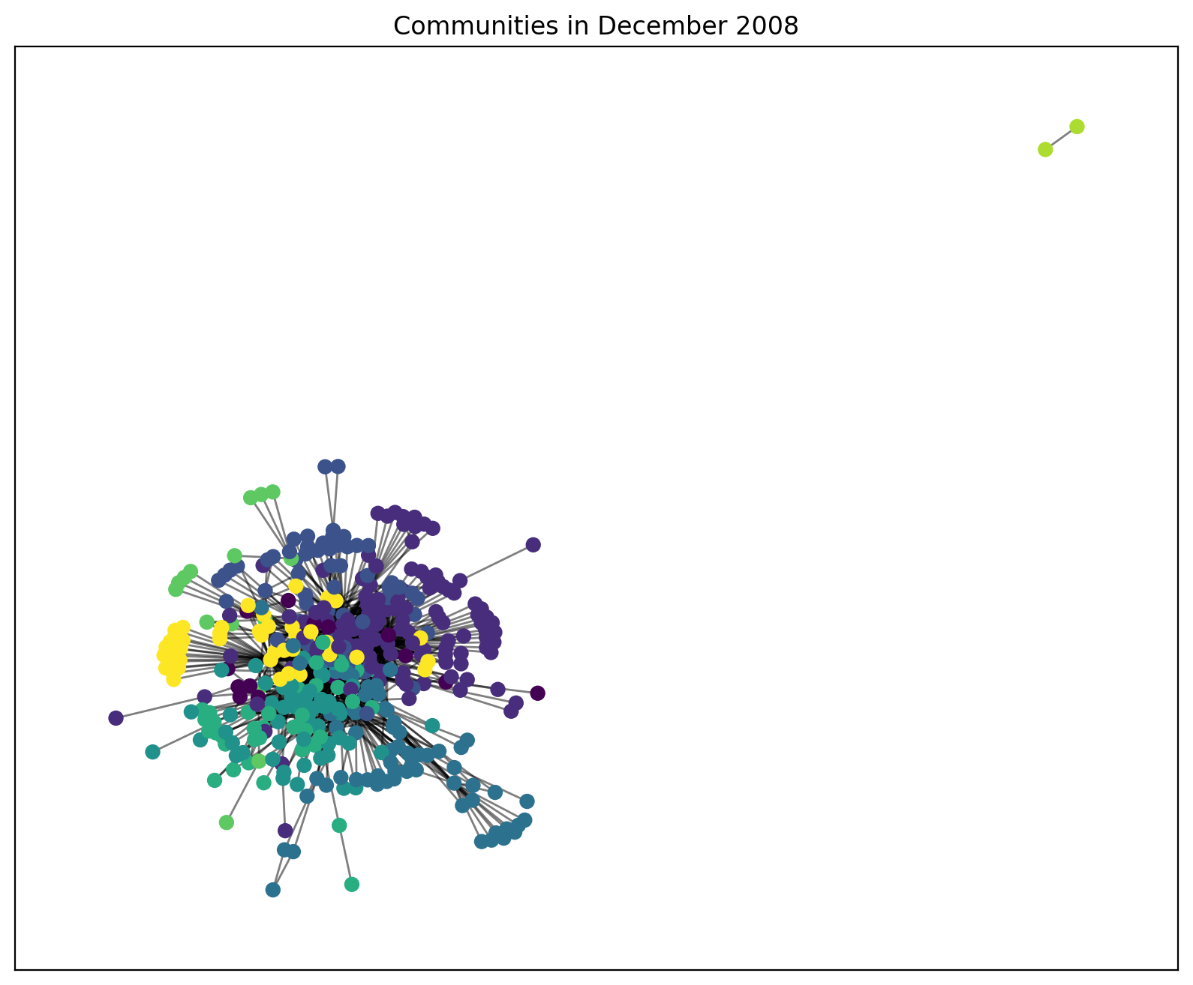
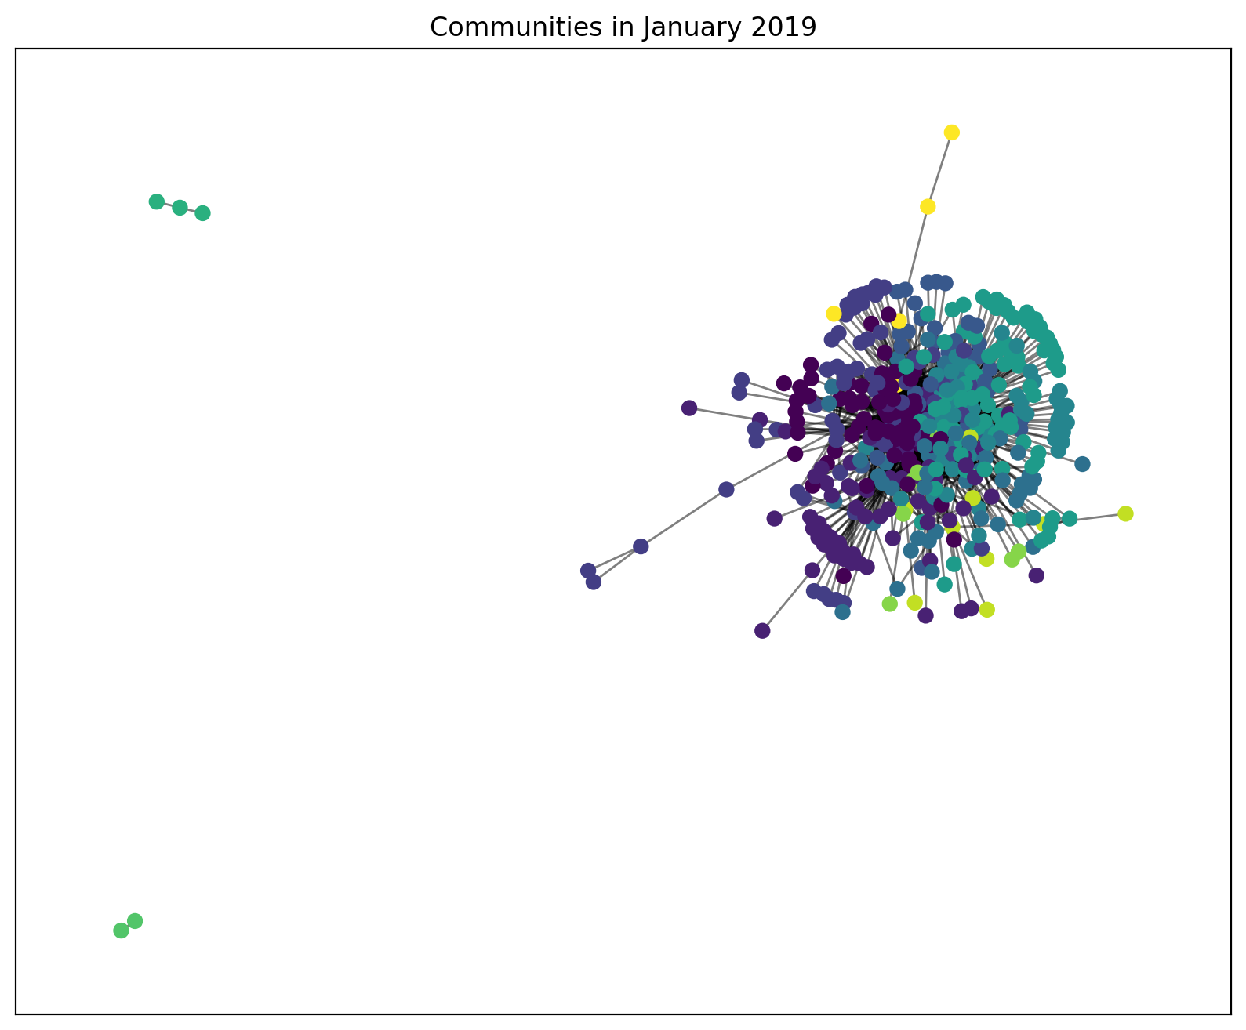
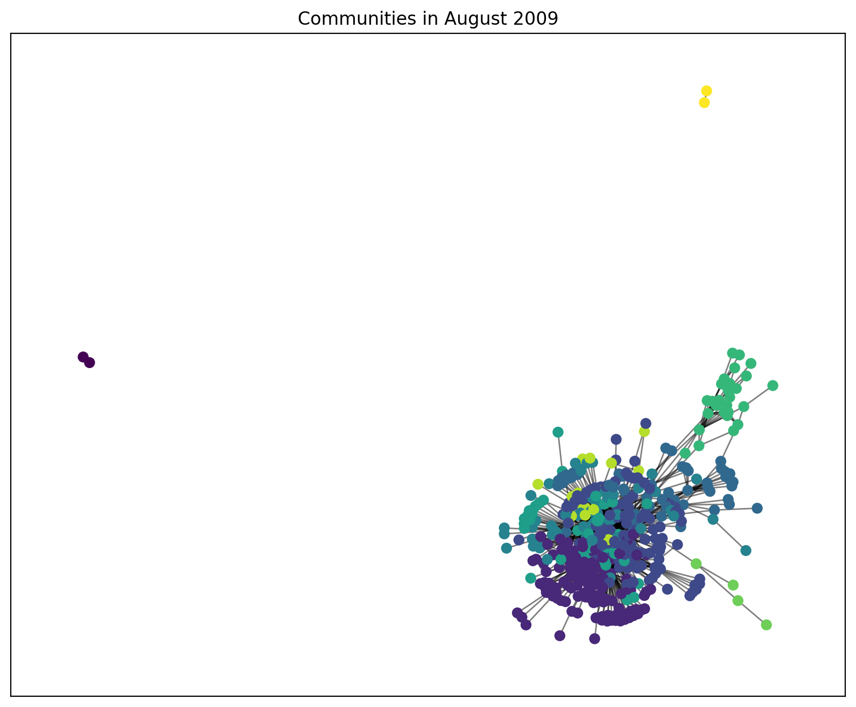
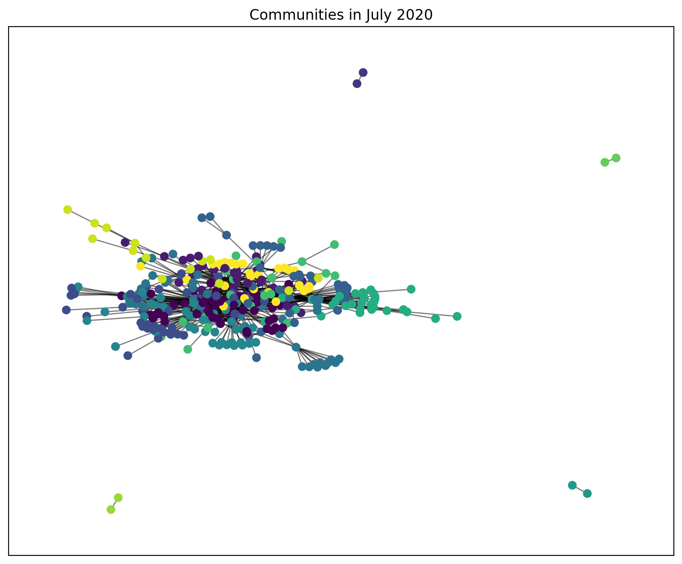
Network Analysis III
Great Recession COVID-19
Notes:
Preyasi

Slide 14
Conclusion
Evolution of International Air Travel:
Examined the evolution of international air travel network from 2000 to 2020.
Identified key network metrics and correlated those with changes in ticket pricing over time.
Significance:
Highlighted the expansion of the aviation industry, and its response to disruption.
Impactful Global Events:
Analyzed the impact on the network of significant global events, like economic crises and COVID-19 pandemic.
Explored how these events and subsequent changes in network correlate to international ticket pricing.
Methodological Insights:
Utilized mathematical network analysis techniques such as PageRank, degree centrality, network density
Uncovered correlations between major airports, and changes in ticket pricing, providing a comprehensive understanding of the intricate dynamics within the international air travel network.
Notes:
Speaker: Manasi

Slide 15
Limitations
Airline Ticket Pricing is Complex
fuel prices, regulatory considerations, seasonal trends
Explored Correlation, not Causation
external factors can influence ticket prices
Limited Data
can’t fully capture long-term trends
Notes:
Speaker: Michael
Although our research provides insights into the correlation between airline network metrics and ticket pricing, it has limitations.
It is important to note that airline ticket pricing is a complex process influenced by various factors. Fuel prices, regulatory considerations, and seasonal trends are just a few of the underlying factors that can affect prices. These are difficult to take into account for our simplified network
We explored correlation and not causation. External factors can affect our results
Additionally, our analysis may not fully capture long-term trends or multifaceted factors contributing to airport significance.

Slide 16
Future Direction
How long term travel industry is shaped by these disruptions
Analyze how different parts of the world have been affected by global events and how airlines have adapted.
Integrate sustainability metrics into the analysis to assess the environmental impact of airline network changes and pricing decisions.
How to improve the resiliency of the network so that it can sustain in crises
Notes:
Preyasi

Slide 17
Thank you!
Questions?

